Slide 1
2nd-7th Sep. 2019, BH19.9 @ Fukuoka, Japan.
Metadata annotation for image data using machine learning
https://github.com/kumeS/BH2019-Fukuoka
Category: Metadata Annotation
Lead: Satoshi Kume
Members: Norio Kobayashi, Hiroshi Masuya (Interested Claus Weiland)
One-line description: Semantic segmentation for the large image data obtained by electron microscopy data and the metadata annotation in the image

Slide 2
Middle wrap-up summary

Slide 3
Schedule
Get ready for the hack.
Preparation of image dataset / check computation env.
Discussion the progress during the BH19
2nd Sep.
BBQ
Preparation of image dataset
DL calc.
Discussed class relations related to ROI
1st DL calc. 8h
failed
3rd Sep.
4th Sep.
2nd run. 5h
Middle wrap-up (3pm)
Mask
Subclass of image
Image => Mask
Maskのクラスをつくる
5th Sep.
6th Sep.
Wrap-up
BBQ
7th Sep.
Paper work

Slide 4
Background & Objective/Task
Background
We developed an ontology “Microscopy ontology” to explain image data, especially electron microscopy images.
We described the metadata for the images including each image and the combined large image using our developed ontology (Kobayashi et al, IJSWIS, 2018.).
We published the images and their metadata via the RIKEN platform (Kume et al, JIST2017.: http://clst.multimodal.riken.jp/RIKENImageDB/).
Issues: (1) Currently we manually add the metadata to each image. It requires time and effort. (2) Only metadata for each image is annotated. It is difficulties to biologically annotate the morphological structures in the image. It is due to no metadata description for ROI &/or masked region and the supporting system. (3) Preparation of training image dataset for DL requires time and effort.
Objective / Task
We discuss the metadata description (phenotypes/morphology) for ROI &/or masked region.
We try the development of the supporting system of metadata annotation for the insight view of images using the machine learning.
We consider an effective amplification of training data from a few dataset.

Slide 5
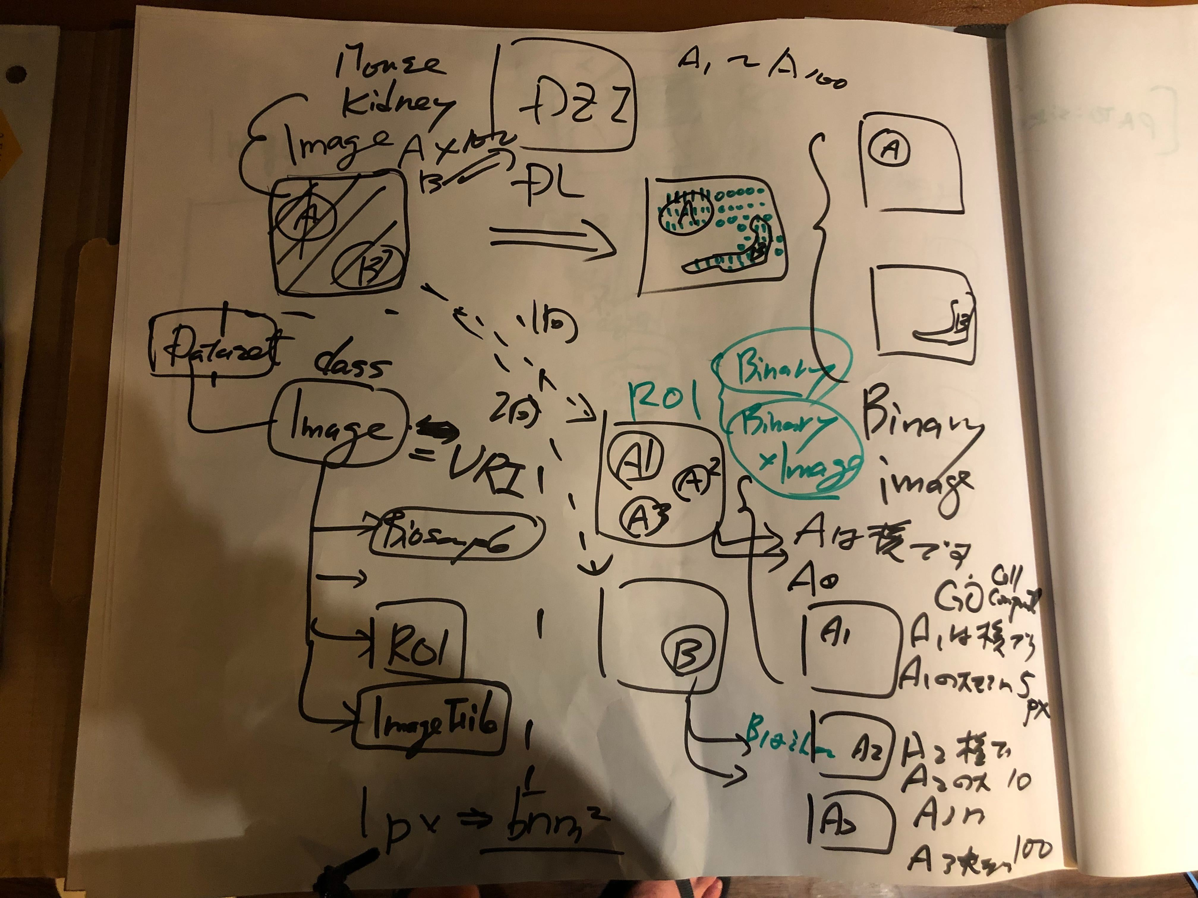
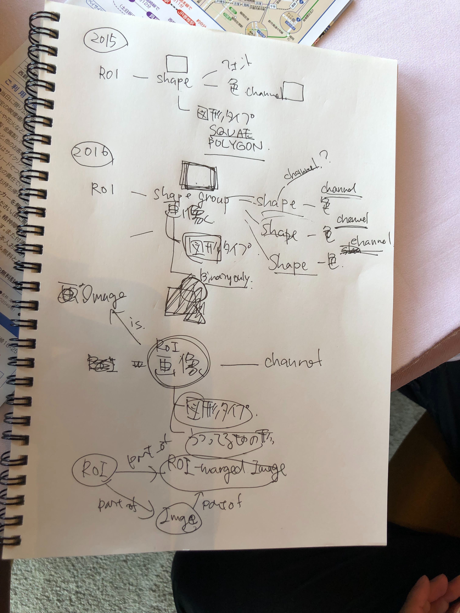
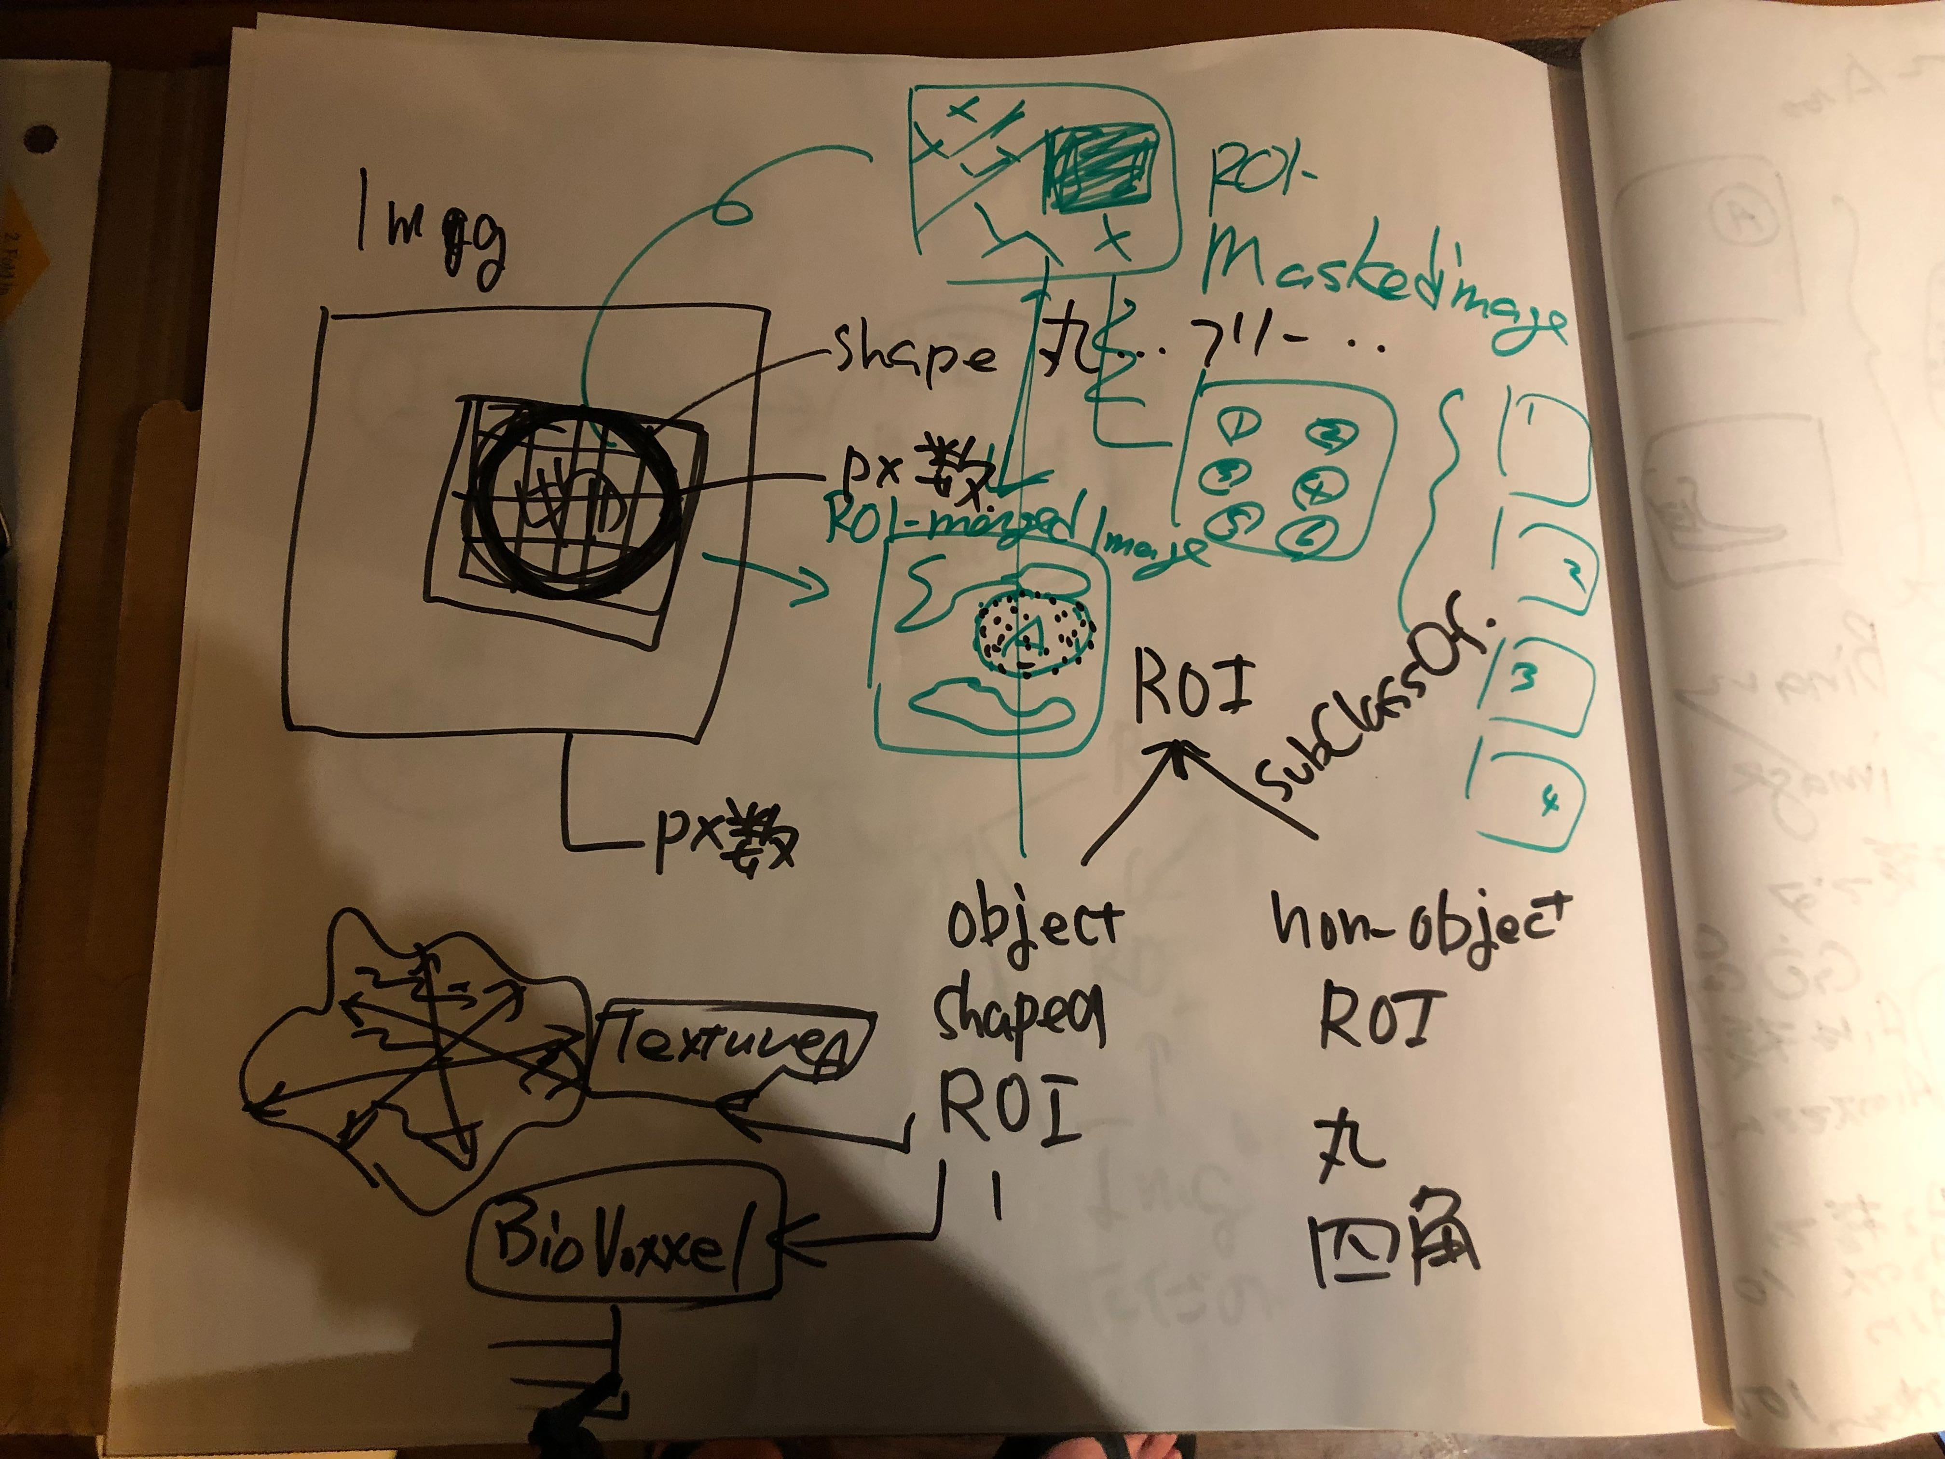
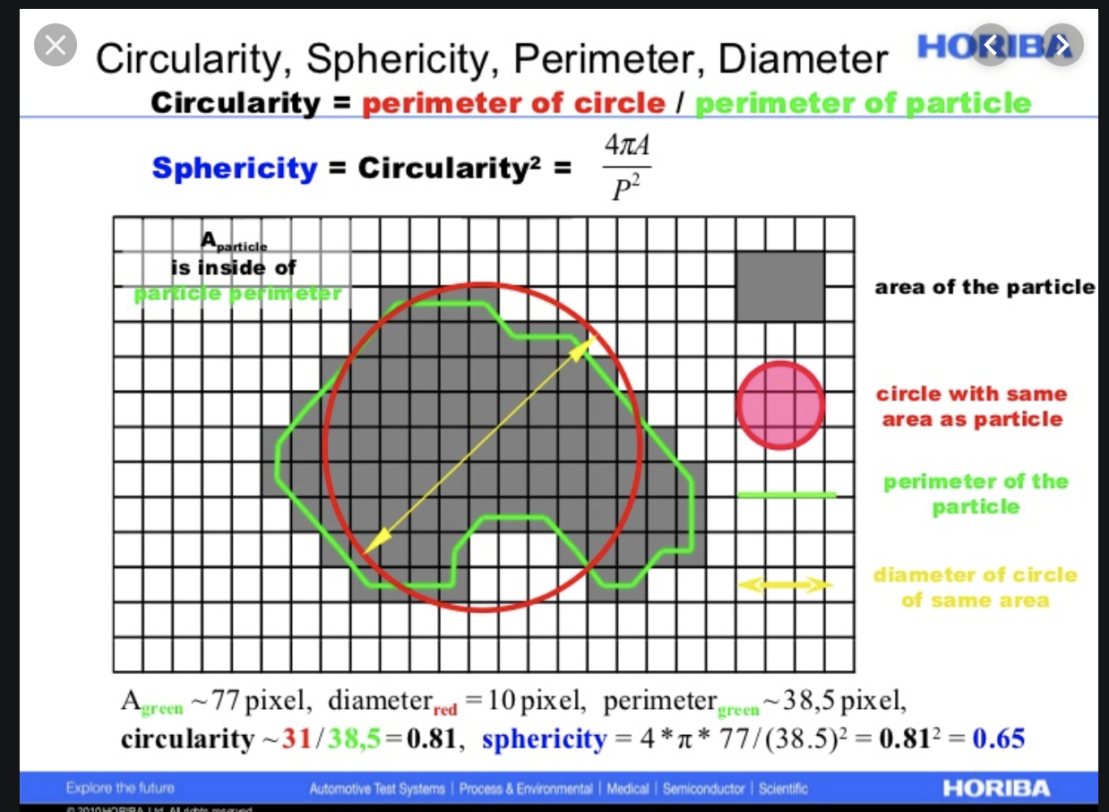
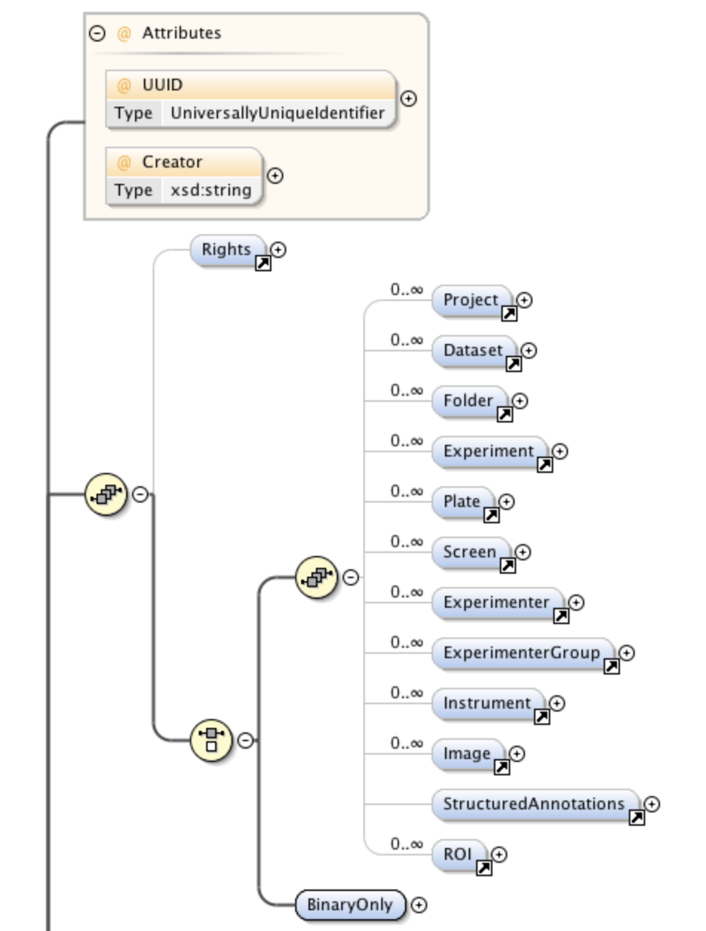
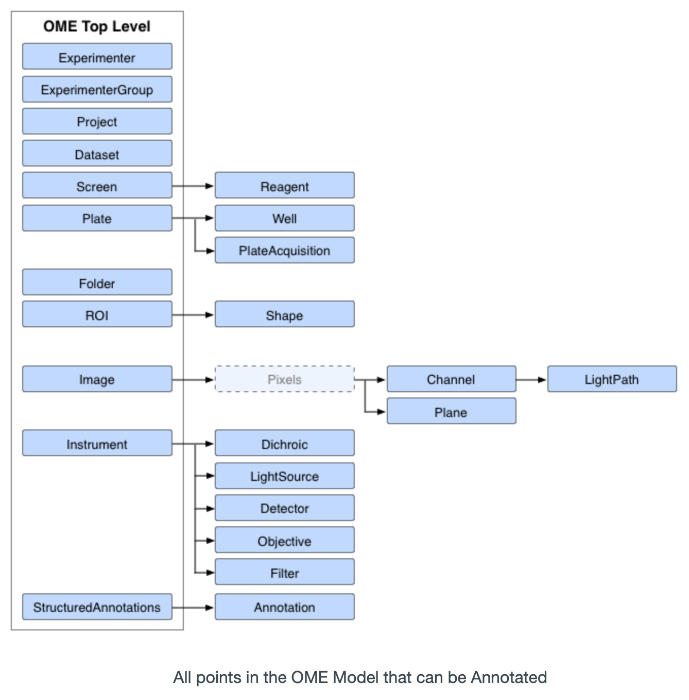
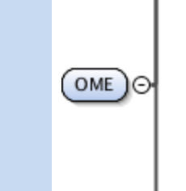
Concept (1) Image metadata for in the the image (ROI: Region of interest)
Class relation
Image
Part-of
ROI-merged image
ROI
Part-of
Part-of
Object-shaped ROI
SubClassOf
Non-object ROI
ROI
DL Prediction
GO CC : GO:0005634
A
Method : ML
Image
B3
Particle shape
B1
B2
BioVoxxel/ImageJ, others
ROI
GO CC : GO:0005739
Method : ML
Particle shape
=> DL
=> 各部位をセグメンテーション、部位検出
=> メタデータを付与 （形態情報、形状・計測データ二次データ: 核やミトコンドリア、その面積等）
=> 位置情報を取得
=> 位置情報とメタデータをメタデータ化
=> DBに格納
=> SPRQL検索
tacit knowledges

Slide 6
Concept (2) For the huge image dataset
Targeted image
Training data

Slide 7
Concept (3) Multi-scale training dataset
Biological scale-level
Small-divided image
Intracellular organelle
scale-level
Middle-divided image
Cell scale-level
Large-divided image
Tissue scale-level
Original image

Slide 8
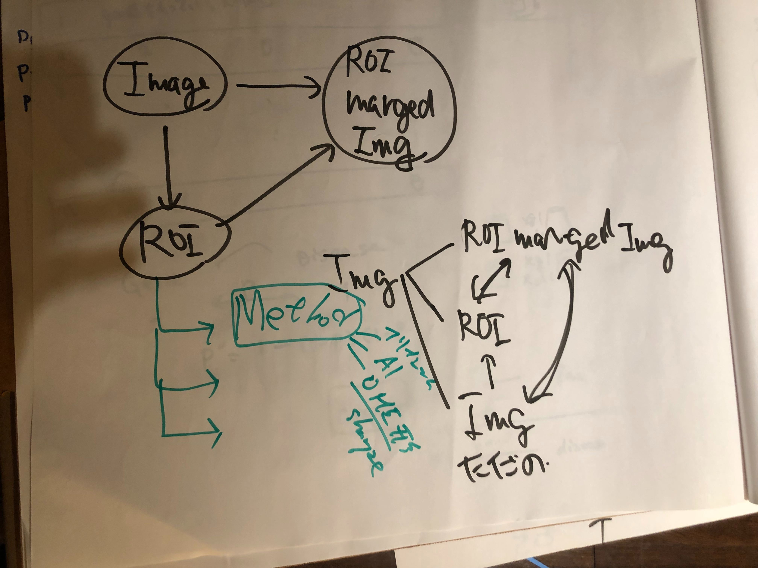
ROI Metadata

Slide 9
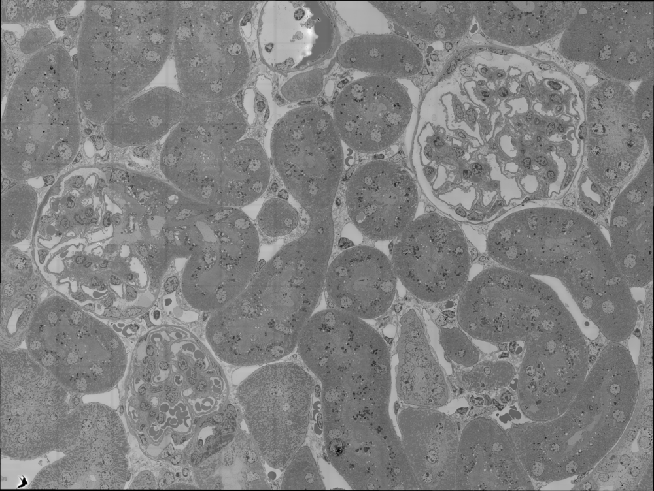
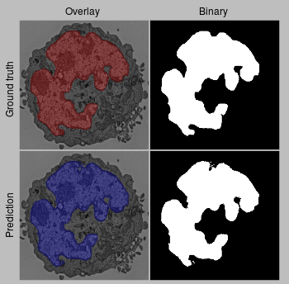

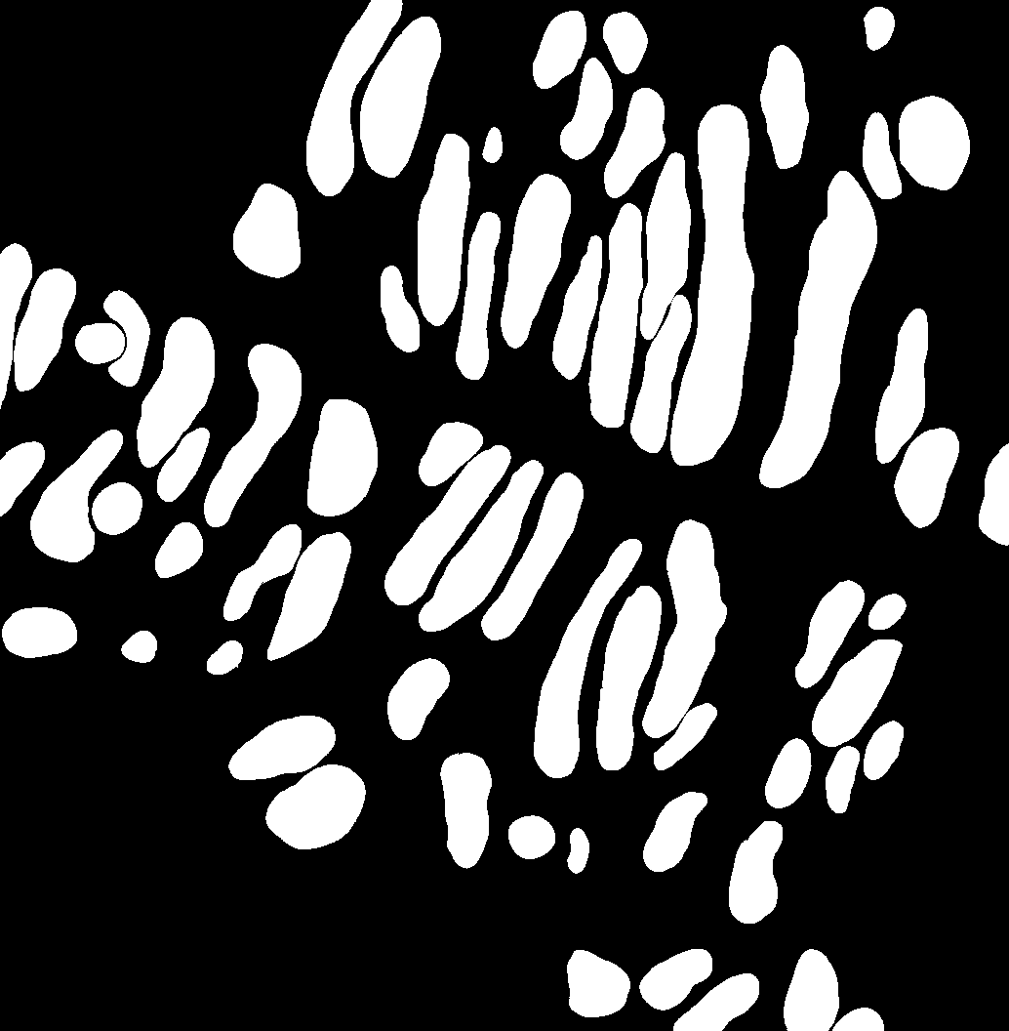
Image Dataset (1)
・Mouse kidney images obtained by electron microscopy
(1) 8-bit grey-scale large image
size : 29158 x 21922 px (tiff: 639.2MB)
(2) 8-bit grey scale divided images and binary images
Full-size : around 1000 x 1000 px
Cropped size :
Ex. ground truth
Nucleus
Mitochondria
核領域
Mouse kidney image
Binarize
Binarize
Available 10-15 image dataset

Slide 10
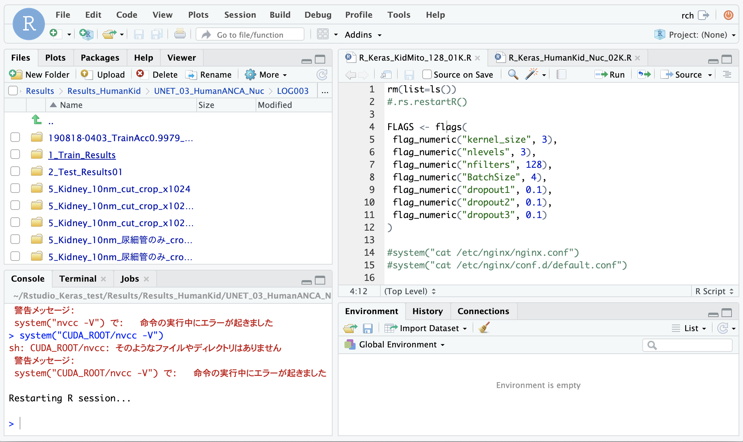



Computation environment in RIKEN Kobe
Machine
PC : HPCT W111ga
CPU : Intel Skylake CPU W-2123 (3.60 GHz, 4Core)
GPU : NVIDIA TITAN RTX (GDDR6 24GB) x 2
Memory : 128 GB
OS / Software
OS : CentOS Linux 7.6.1810
NVIDIA Driver : 418.67 / gcc : 4.8.5
CUDA : V9.0.176
Rstudio (R version 3.6.0), R-Keras 2.2.4, TensorFlow 1.11.0 (Backend)

Slide 11
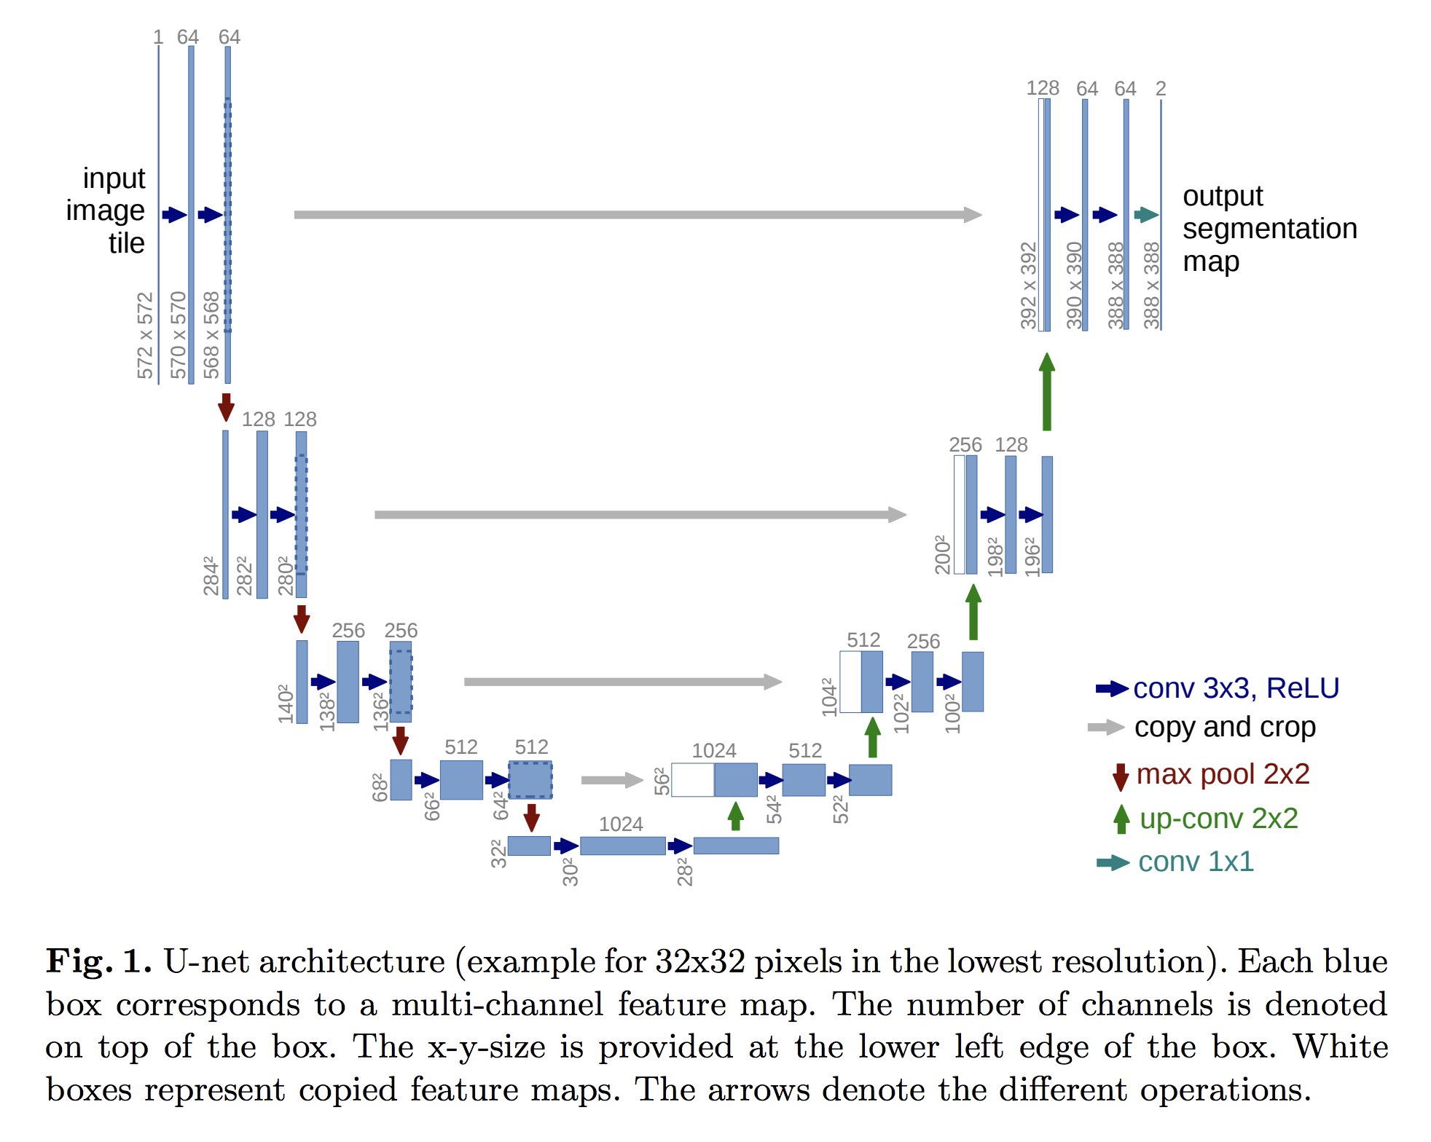
Image segmentation using deep learning
？？？
？？？
？？？
Ronneberger, O. et al., MICCAI 2015, 2015. (arXiv:1505.04597v1)

Slide 13
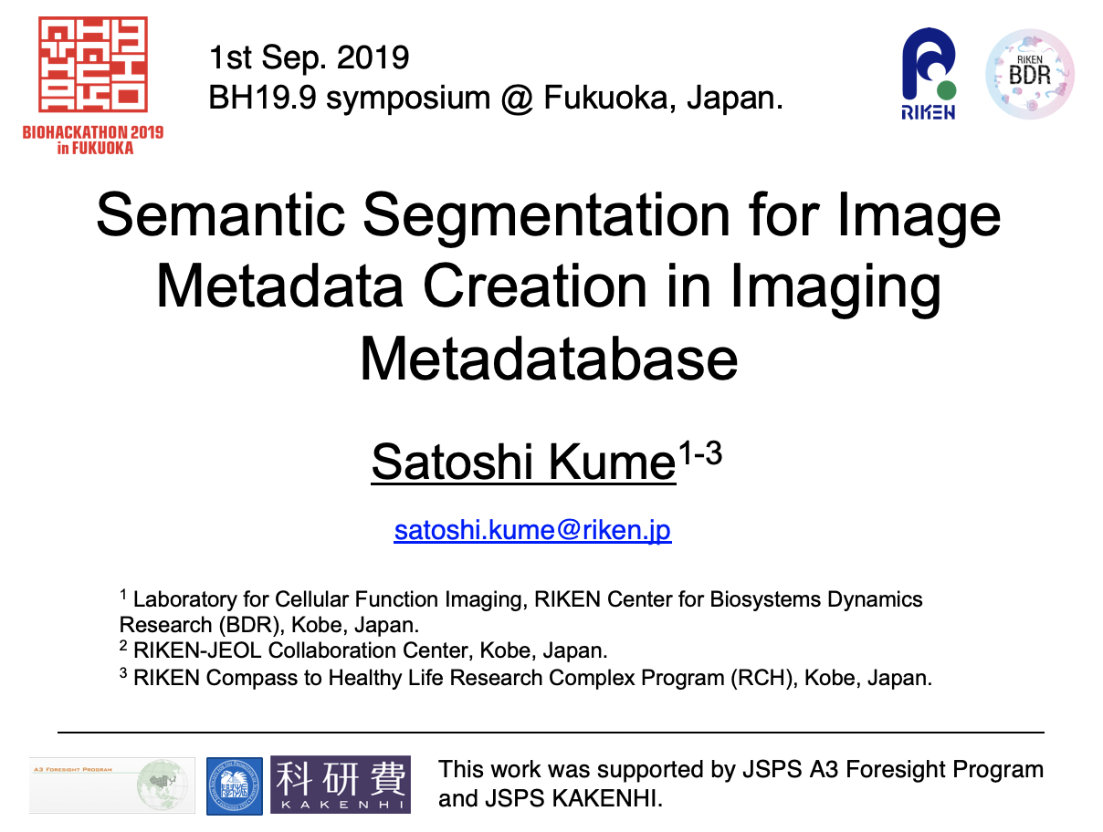
1st Sep. 2019
BH19.9 symposium @ Fukuoka, Japan.

Slide 14
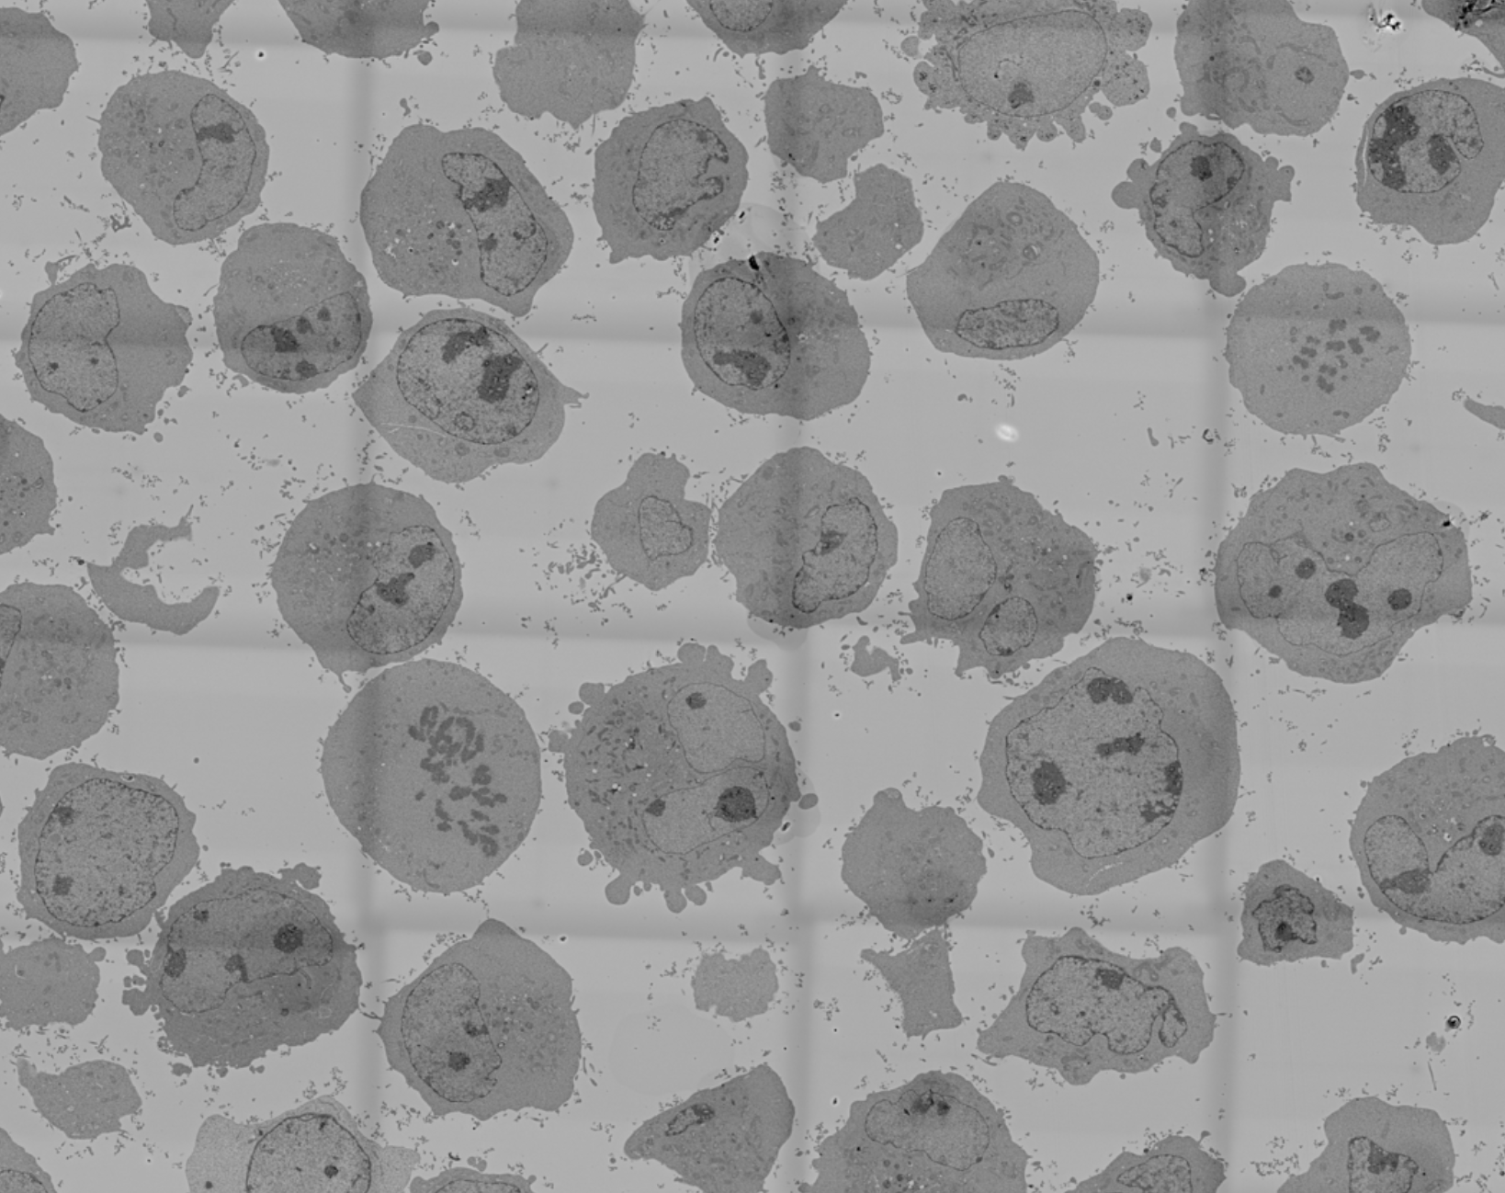
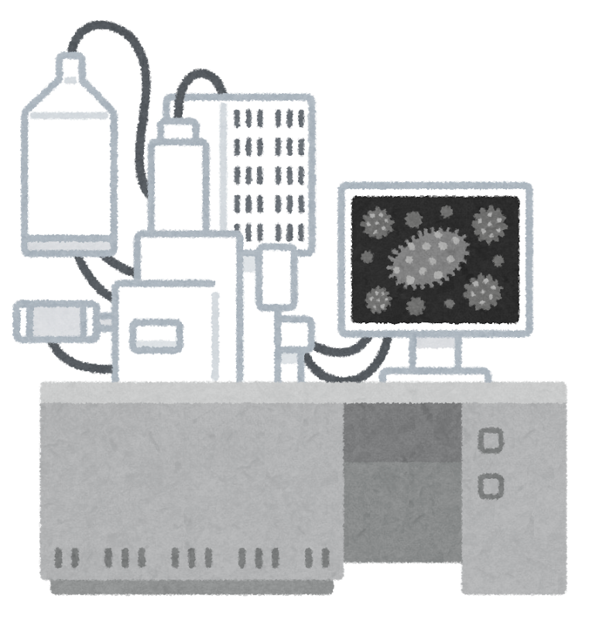
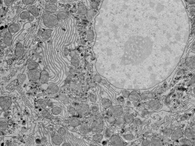
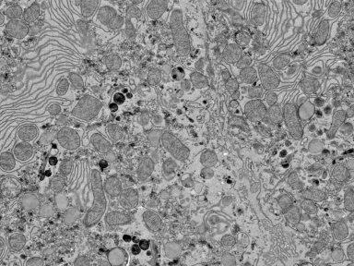
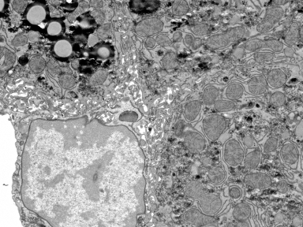
Background & Objective
Imaging data in life science is various types of data.
Many imaging modalities => various microscopes (fluorescence/electron), etc
Many biosamples => human samples, animals (Mouse, Rat) and others
Many experimental condition => stanning conditions, time, temp., Anti-bodies, etc
Issues
No standardization description (including ontologies) for imaging data
No RDF-based operation platform for images and their metadata
Image data storage, sharing huge image data, and automatic-metadata annotation were still not addressed.
Our challenges
Data production
Metadata description from the data production to the public sharing of images in the case study of “Electron Microscopy (EM) images“
Blood cancer cells
EM Image

Slide 15


RDF-based metadata for
Microscopy Imaging Data
Open Microscopy Environment (OME) : XML-based data schema
(OME is maintained by Swedlow Lab, University of Dundee, Scotland, UK)
New vocabularies
Electron microscopy (EM) concepts
Experimental conditions
Biosample information
etc
RDF/OWL-based ontology
Kume et al, ISWC2016.
Kume et al, JIST2017.
Kobayashi et al, IJSWIS, 2018.

Slide 16
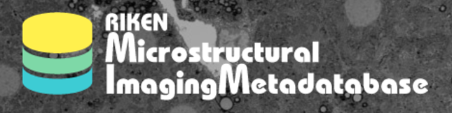
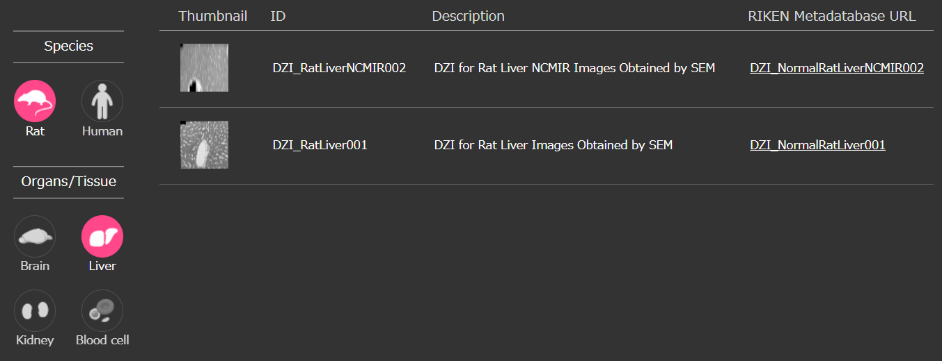
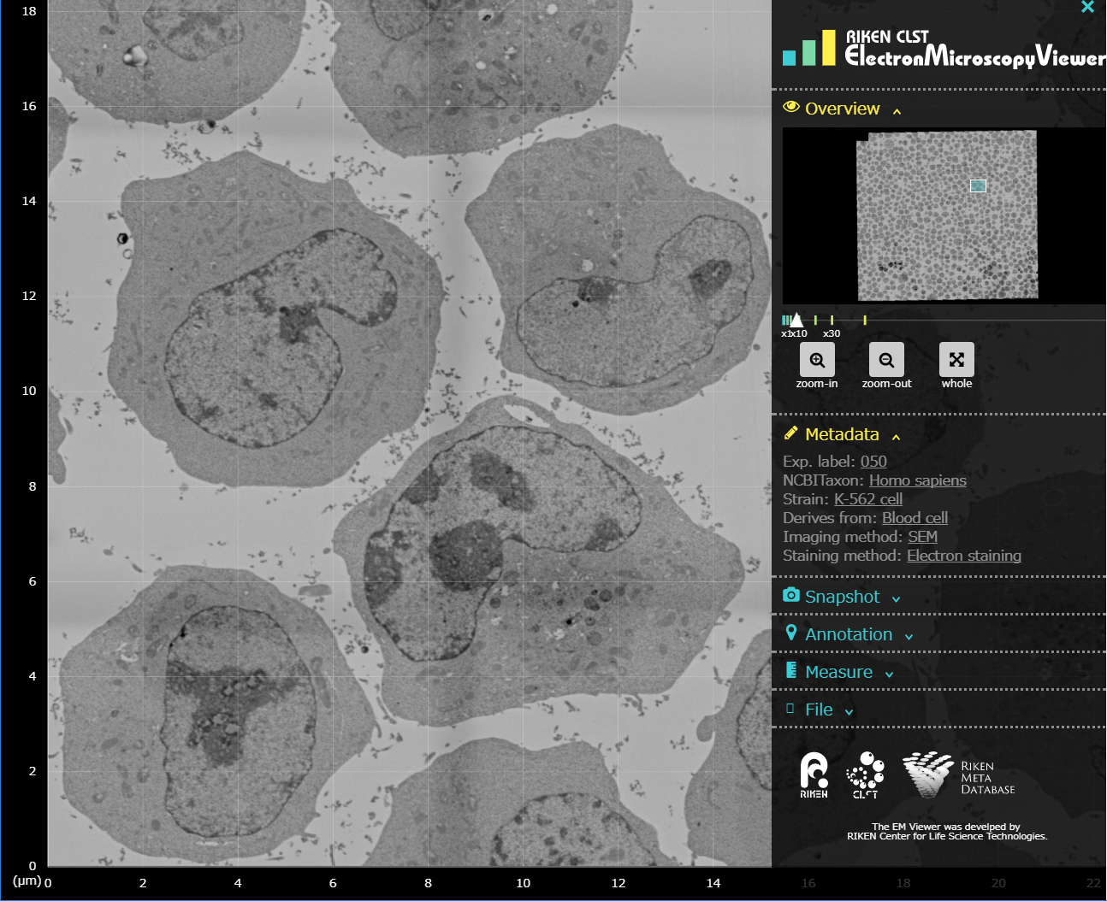

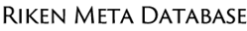
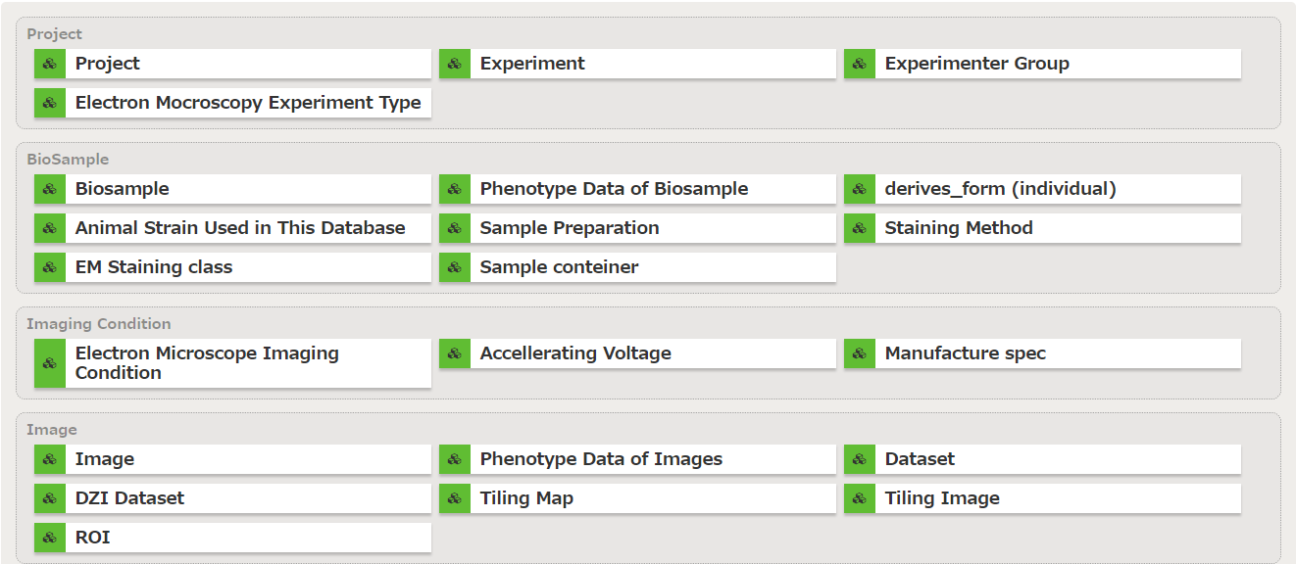
RIKEN Microstructural Imaging Metadatabase
http://clst.multimodal.riken.jp/RIKENImageDB/
This metadatabase provides an easy-interface for searching imaging data from the RIKEN database platform and can display a large image through our developed image viewer.
Image viewer (DZI image)
Image list
SPARQL Search
Metadata
Imaging metadata
Kume et al, JIST2017.

Slide 17
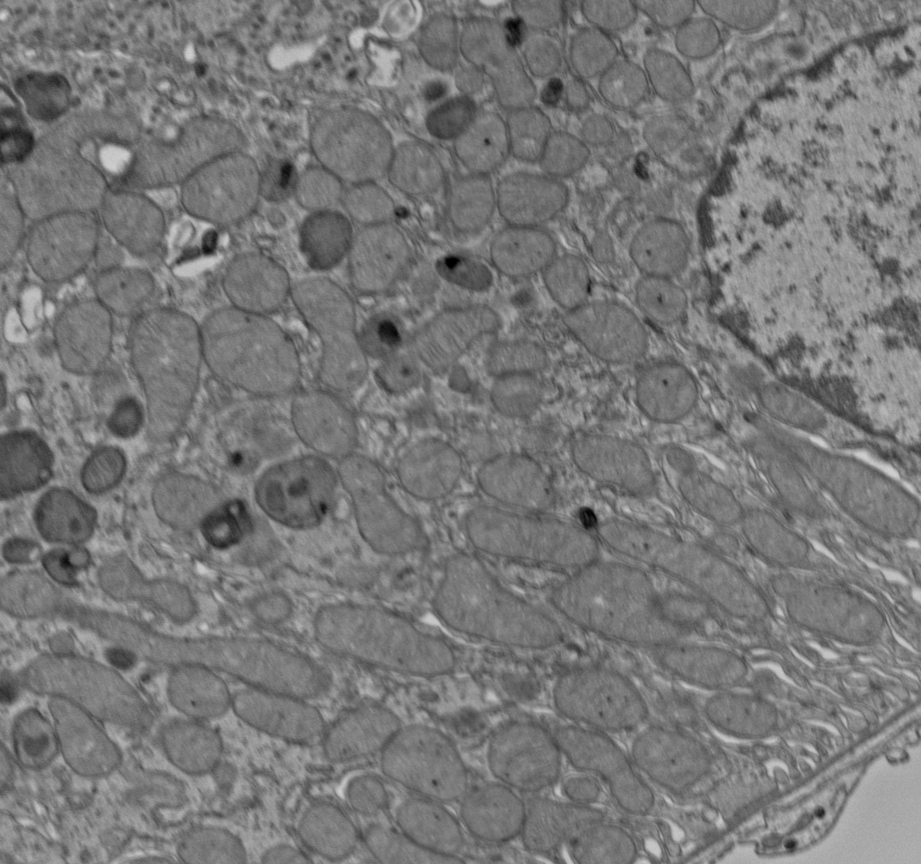
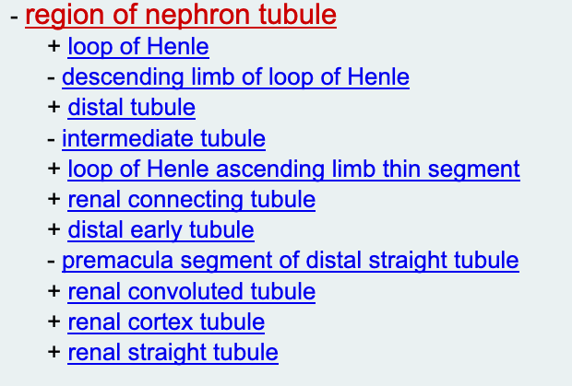

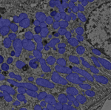
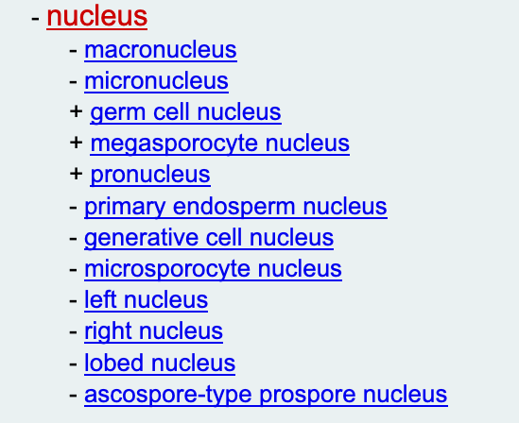
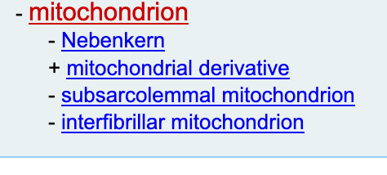
To do in BH 2019
Current
EM Image
Currently we add the metadata for each image manually.
Uberon: UBER-anatomy ontology
Ex. An EM image of mice kidney
But the image includes more information.
BH19
Multiple image segmentation using deep learning
Macroscopic/whole segmentation
Tissue type / Cell type
Uberon
others
Microscopic/local segmentation
Gene Ontology &/or others
Intracellular organelle
Shape quantitation
I also expect to conduct statistical analysis and cell shape analysis during BH.

